Slide 1
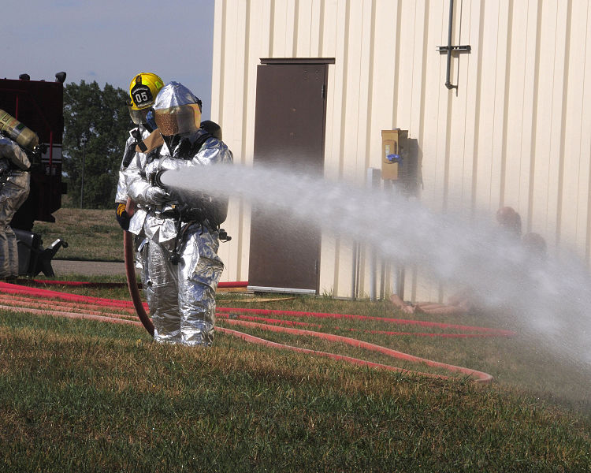
Microsoft Azure
A Look at Planning and Provisioning Infrastructure and Platform as a Service
Presented by Jim Leonardo
Notes:
We’re going to talk about the general concepts of Infrastructure as a Service and Platform as a Service. This talk will include a lot of architectural ideas and then we’ll show a bit on how to get some infrastructure deployed to Azure. Because I’ve worked primarily with Azure, this talk will focus on Azure, but the concepts behind it can be carried over to AWS. My main goal is to share the experience I’ve had consulting on and implementing custom apps in Azure and just sharing some of what I’ve learned about getting started on a project.

Slide 2
About Jim
I am an application architect and software development manager with nearly 20 years of development experience who still loves to code as a large part of my day job.
Since 2013, I’ve been focused on leading the design and build of custom applications hosted in Azure for a variety of organizations.
I currently work for kCura on the RelativityOne cloud based eDiscovery SaaS platform.
Contact Me:
jimleospeaks@outlook.com
linkedin.com/in/jimleonardo
jimsrulesregardingeverything.com
Or via our Meetup group
Notes:
We’re hiring!

Slide 3

Warning
Opinions Ahead

Slide 4
Who Thinks About What?
What | IT | Development | Users
Infrastructure | ü
App Environment | ü | ü
Applications | ü | ü | ü

Slide 5
Quick Definitions
Infrastructure as a Service – “Managing your data center”
Platform as a Service – “Managing your services”
Functions as a Service – “Managing your logic”
Software as a Service – “Managing your applications”
Notes:
The “as a service” ultimately comes down to what are you managing?
IaaS has you thinking like IT
PaaS/FaaS have you thinking like development
SaaS has you thinking like the business

Slide 6
Azure Services*
* Just a few!
Notes:
When you think about it, it wasn’t that long ago when we had only cloud services and storage. The Azure service offerings have grown RAPIDLY.

Slide 7
“Microsoft” Examples
IaaS
Paas
Data Center
Networking
Servers
Storage
Operating Systems
Development Tools/Frameworks
Database Management
Analytics
see https://azure.microsoft.com/en-us/overview/what-is-paas/

Slide 8
Control and Management
Notes:
This is an illustration, there’s no math here. Control vs management effort will vary with what you need to do.

Slide 9
How to Choose
Generally, pick the highest level of abstraction that can possibly work.
When moving existing applications from traditional data centers, “Can possibly work” usually means VMs first.
Remember that in terms of raw, single threaded throughput and IO, Azure will always lose out over your traditional data center.

Slide 10
Typical Scenarios
“On Prem” | IaaS | PaaS
Special Software | Legacy Applications | New Applications
Special Hardware | Complex Application Environments | “Normal” Web Apps
Real Time Hardware Control (e.g. CNC) | Custom Environments | Need “burst” performance
Ultra High Security Needs | Third Party Environments | Small Operations team
Offline Operation | Hybrid Apps | Public Internet Facing
Notes:
Remember the lines are blurring.
VM Scale Sets simplify bursting in IaaS
Premium App Services control networking.

Slide 11
Organizing Multiple Services

Slide 12
Availability Sets
Notes:
When you think about it, it wasn’t that long ago when we had only cloud services and storage. The Azure service offerings have grown RAPIDLY.

Slide 13
Storage Replicas
Notes:
When you think about it, it wasn’t that long ago when we had only cloud services and storage. The Azure service offerings have grown RAPIDLY.

Slide 14
Cloud Performance
Async & Parallel
“Parts”
Specialized Services
Scale Out
DRY
Synchronous & Single Threaded
Monoliths
Generalized Services
Repetitive
Scale Up
Notes:
Async v Synchronous
Queue based patterns
Async coding that yields up the processor when threads are waiting on other things
Especially thing about this for workflows that are inherently async (sending an email)
DRY v Repetitive
Cache data, don’t always go to data store
Strongly consider how much you can leave on the client side once the client gets it (e.g. don’t re render menus server side for the gazillionth time for that user)
Chunky vs Monoliths
Keep each deployable unit focused so that you can choose the right hosting mechanism.
Don’t simply deploy VMs that have multiple processes running on them because that’s how you did it on prem
Scale down and up so that you have reasonably high utilization metrics.
Minimize the frameworks, etc on each unit.
Specialists and Generalists
Let SQL Be relational. Don’t store documents in nvarchar(max) or binary. Store them in blob storage or elsewhere
Each server, function, etc should have a single purpose.
Scale out not Up
Don’t try to throw more raw performance at it, make it go wide.
There is a finite limit to up, but we can go very, very wide.
Think of it as trying to build Facebook with Raspberry Pis as your servers.
Consider sending email:
Email is async anyway!
Don’t create email on the main application thread.
Send a message to a queue with some basic info on what should be in the email (type of message)
Have some consumer listening to that queue that picks it up and does the formatting and sends it.

Slide 15
My Favorite Cloud Patterns

Slide 16
Getting the Most out of the Cloud
Go Wide, not Tall
Asynchronous as much as possible
Message Queues, Topics, Event Hubs, etc
Eventual Consistency
Log or Die
Use Resource Groups and App Service Plans to organize.
Drive Complex Web Apps from REST APIs.
Cache intelligently and aggressively.
The cloud helps with HADR, but you need to own it.
Notes:
Wide, not Tall
-Cloud scales OUT, but scaling up is hard.
Asynchronous as much as possible
Message Queues, Topics, Event Hubs, etc
Drive Web Apps from REST APIs
No “Kitchen sink” post backs
Aggressive Caching
Eventual Consistency
Log or die
Use Resource Groups to organize

Slide 17
Provisioning and Deploying
Provision
Deploy
Use
Create Environment
Setup Application

Slide 18






About those snowflakes…

Slide 19
Operations as a Feature
Operations on Day Zero
Defined HADR/BCDR with RPO and RTO
Monitoring and Logging tools are in place
Monitoring and Logging are centralized
Some supplemental tools (e.g. 3d party web analytics) may not be central.
The HADR/BCDR plan and tools are tested frequently

Slide 20
Infrastructure as Code
New environments are automated as “one touch” scripts and configuration files.
Updates to the environments are also automated.
“Anyone” can create a new environment, including devs.
Those scripts and configuration files part of a source code repository (this may be different from application repositories).
Tested throughout the org’s SDLC: Dev through Prod.
HADR/BCDR are “highly” automated.
Just some tools to help:
Powershell (including Powershell DSC)
ARM Templates
VSTS/TFS
Chef
Puppet
Octopus Deploy

Slide 21
Demo
Notes:
Discuss uniquestring
Discuss credentials/secure string
Discuss keyvault
Discuss params file and also how to add params direct from New-AzureRmResourceGroupDeployment
Beware “SELECT” mode (quick edit)

Slide 22
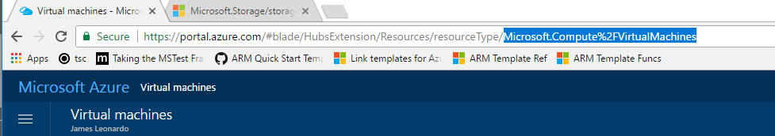
ARM Templates – Finding the Reference
https://docs.microsoft.com/en-us/azure/templates/microsoft.compute/virtualmachines
Where to get the type name?
From a sample template
From the portal url
Base Url
Type Name

Slide 23
VERY IMPORTANT VM NOTES
If you shutdown VMs from within the OS, you will still be billed for the VM. This is because Azure is still allocating resources to the machine.
Instead, Shutdown VMs using the Azure shell or portal to stop billing.
Remember “D:” is fast but temporary. If the machine reboots, you may lose anything on it. It’s great for cache or storage you may need while processing data, but make sure you have that data elsewhere.

Slide 24
The future?

Slide 25
Handy References
https://docs.microsoft.com/en-us/azure/architecture/patterns/
https://docs.microsoft.com/en-us/azure/templates/
https://docs.microsoft.com/en-us/azure/azure-resource-manager/resource-group-template-functions
https://github.com/Azure/azure-quickstart-templates
https://resources.azure.com/
http://download.microsoft.com/download/8/E/1/8E1DBEFA-CECE-4DC9-A813-93520A5D7CFE/World%20Class%20ARM%20Templates%20-%20Considerations%20and%20Proven%20Practices.pdf
This work by James Leonardo is licensed under the Creative Commons Attribution-ShareAlike 4.0 International License. To view a copy of this license, visit http://creativecommons.org/licenses/by-sa/4.0/.

